Slide 1
Mine-Max

Slide 2
CONTENTS
INTRODUCTION
EXISTING SYSTEM
PROPOSED SYSTEM
UNSTRUCTURED DATA
UNSTRUCTURED DATA MINING

Slide 3
INTRODUCTION
Mine-Max is a framework for handling any kind of unstructured data.
It performs unstructured data mining, storage, analysis and visualization of the data.
The system takes unstructured data from various sources as input.

Slide 4
EXISTING SYSTEM
The existing system is domain oriented, i.e..,
> Stock exchange data > Shopping site data > Medical data, etc.
The existing system have complex user interface
Only the programmers can handle the system

Slide 5
PROPOSED SYSTEM
The proposed system can handle all kinds of unstructured data.
Simple and effective user interface.
The system can be handled by anyone.
The system can find out the hidden information from the unstructured data.
It also provides: Data analysis, storage and visualization using various methods.

Slide 6
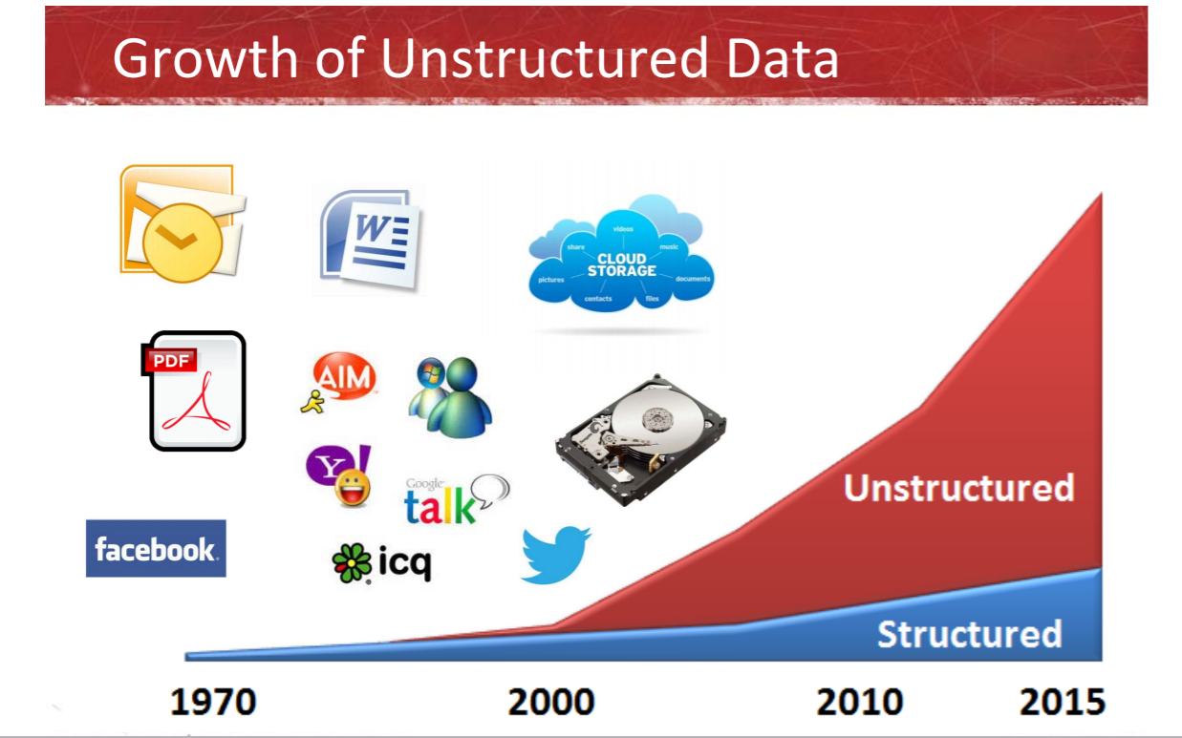
UNSTRUCTURED DATA

Slide 7
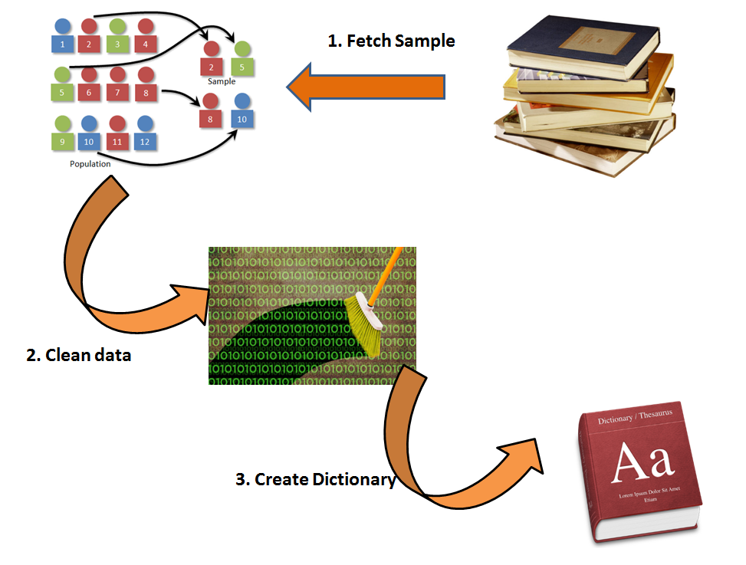
UNSTRUCTURED DATA MINING

Slide 8
UNSTRUCTURED DATA MINING
Step 1 : We take a random/stratified sample text to build a dictionary.
Step 2 : Clean the data
Step 3 : Extract the most frequently occurring words

Slide 9
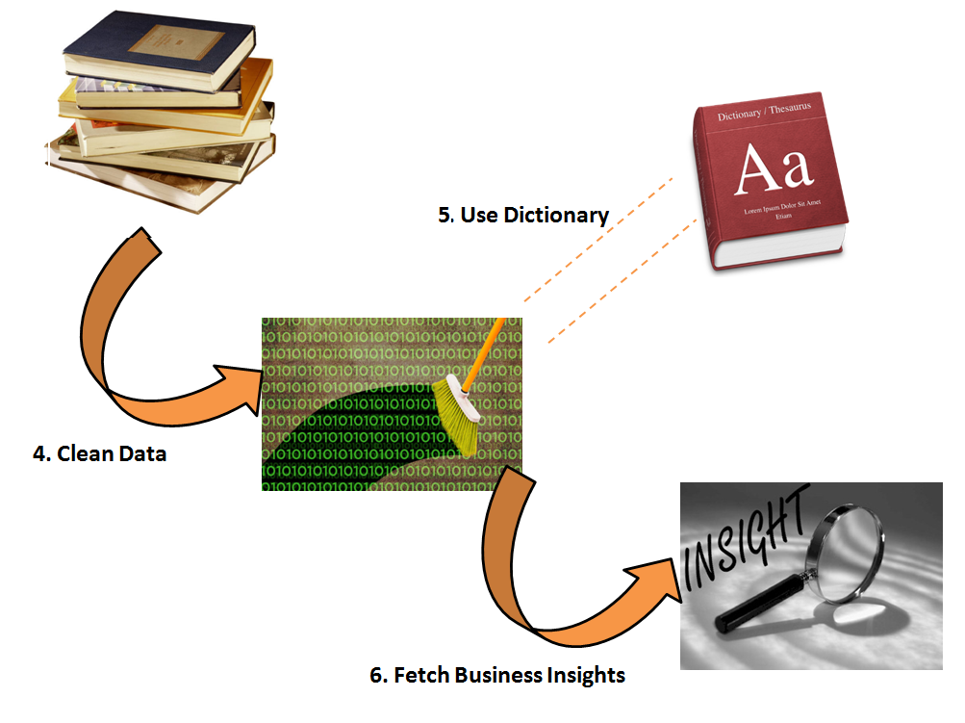
UNSTRUCTURED DATA MINING

Slide 10
UNSTRUCTURED DATA MINING
Step 4: Clean the entire data-set for make sure that the dictionary we have created in step 3 works on this entire dataset.
Step 5 : Using the dictionary, we can categorize each transaction statement.
Step 6: Once we have tags of category on each transaction statement, we can summarize the entire dataset to fetch business insights and frame business strategy.

Slide 11
References
https://chapters.theiia.org/topeka/Documents/Topeka%20IIA%20Nov5%20Printable.pdf
https://www.analyticsvidhya.com/blog/2014/08/understanding-analyzing-hidden-structures-unstructured-dataset/
https://github.com/topics/unstructured-data
The Text Mining Handbook: Advanced Approaches in Analyzing Unstructured Data By Ronen Feldman, James Sanger

